Slide 1
IQ puzzles and brain teasers
Level 3B

Slide 2
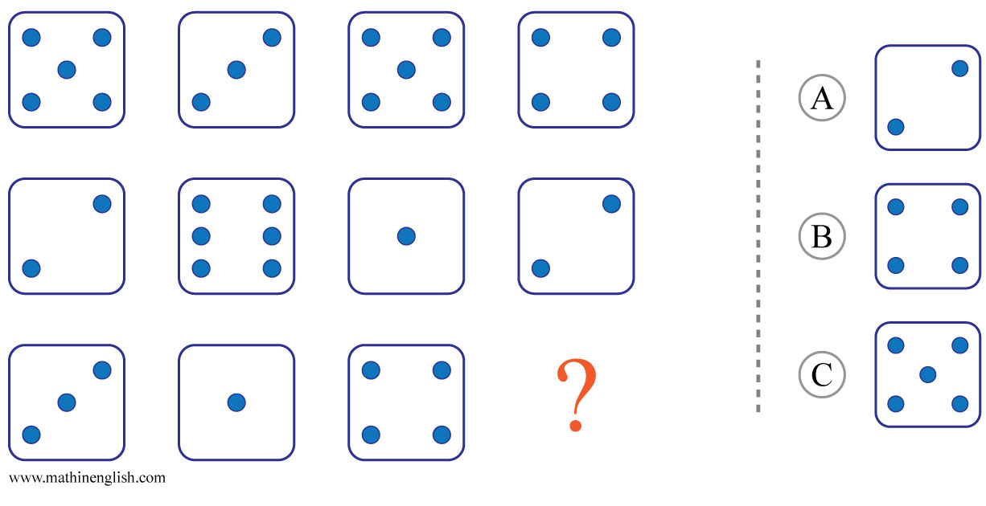
IQ Puzzle 1
Level 3B
Which option is correct?

Slide 3
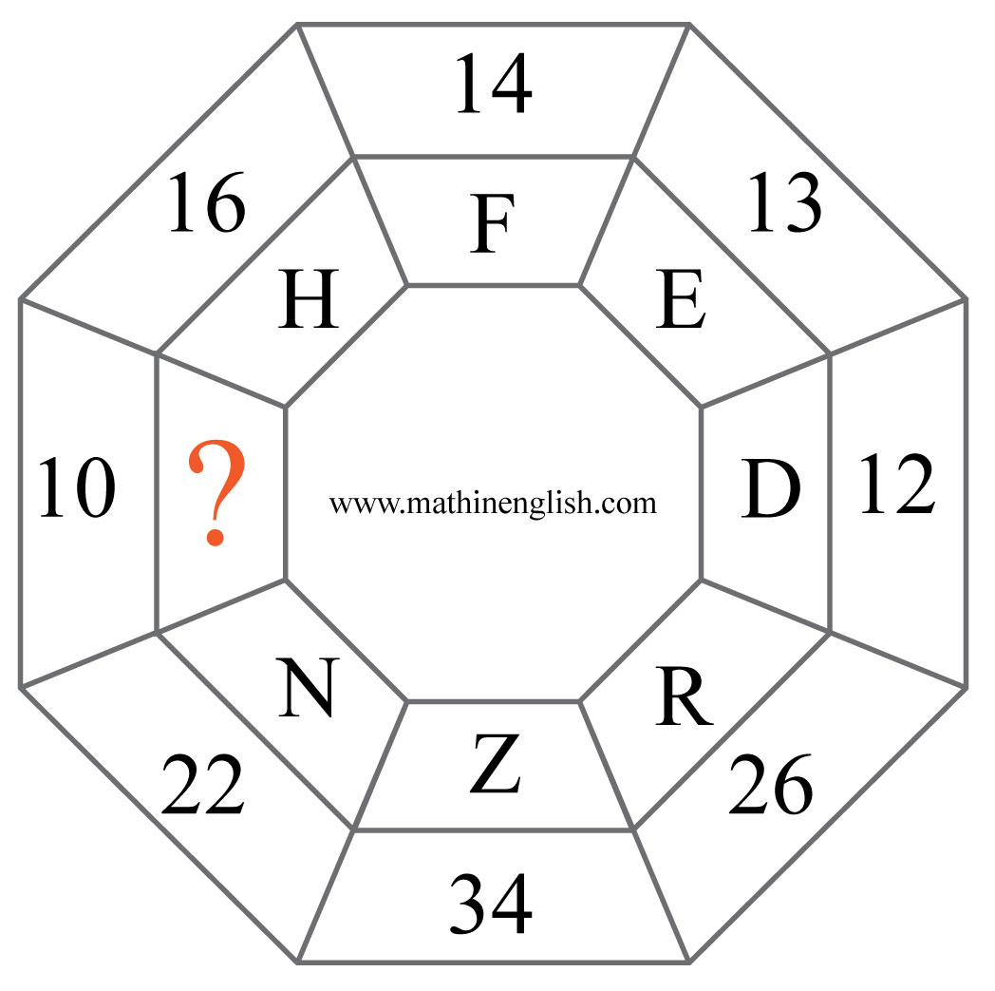
IQ Puzzle 2
Level 3B
Which letter is missing?

Slide 4
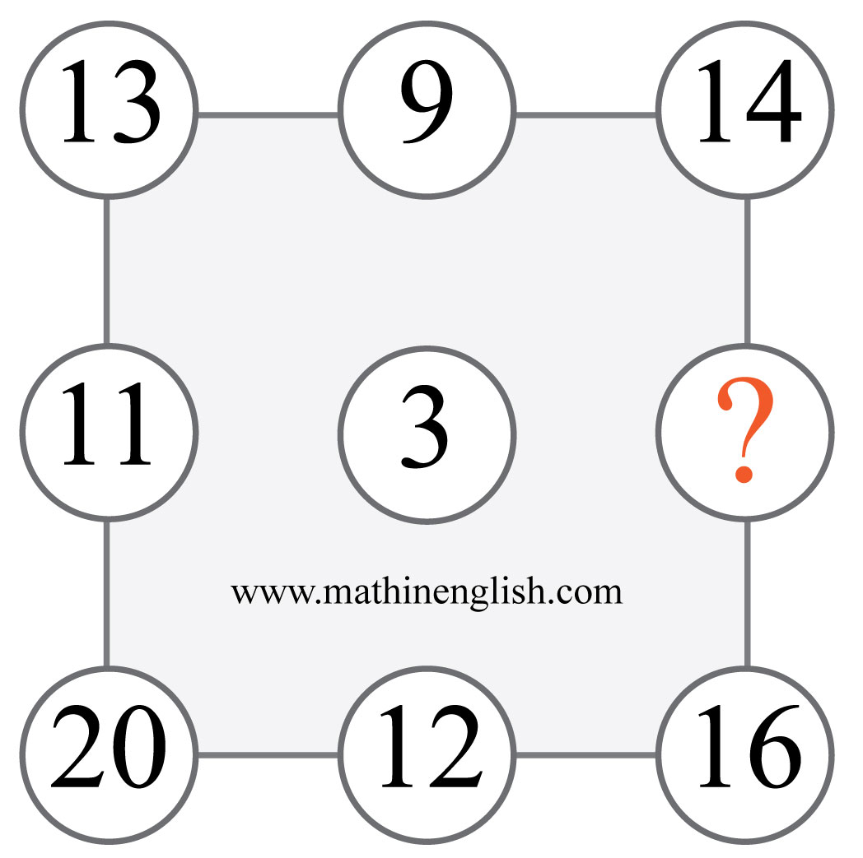
IQ Puzzle 3
Level 3B
What is the missing number?

Slide 5
IQ Puzzle 4
Level 3B
What number is needed here?

Slide 6
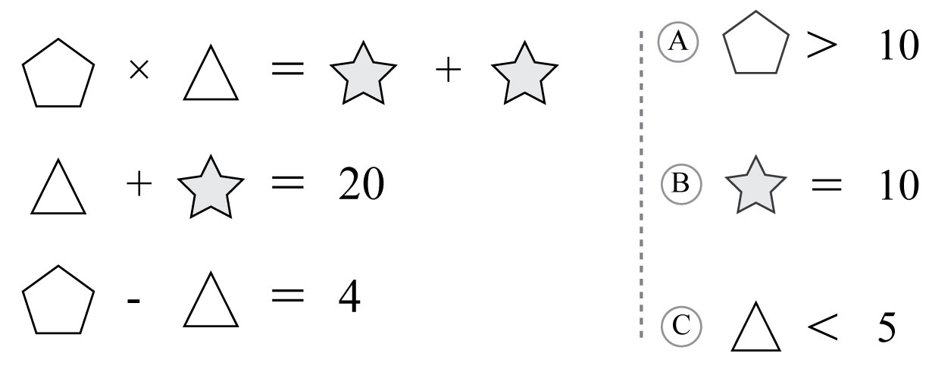
IQ Puzzle 5
Level 3B
Which option is correct?

Slide 7
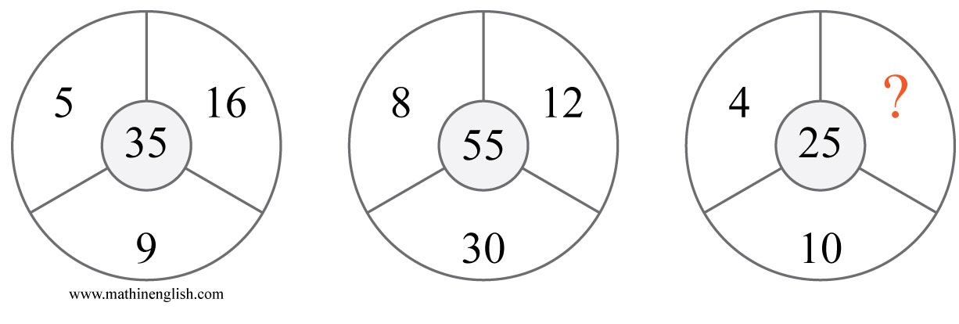
IQ Puzzle 6
Level 3B
Which number is missing?

Slide 8
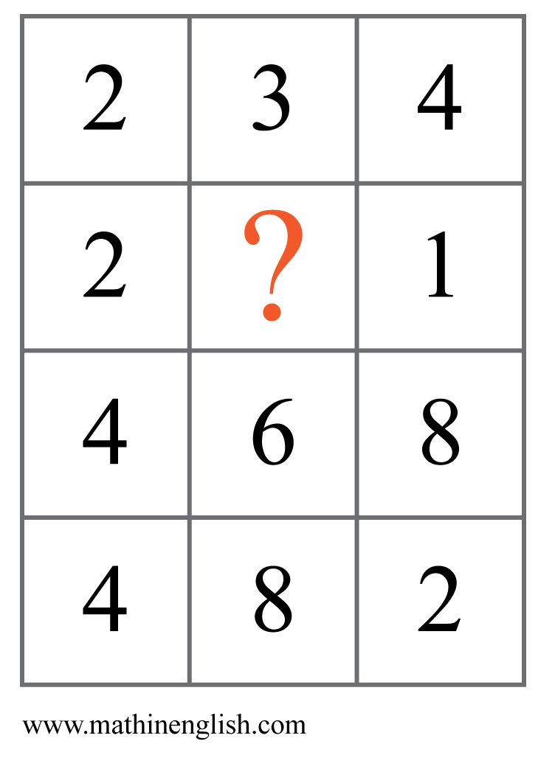
IQ Puzzle 7
Level 3B
Which number is missing?

Slide 9
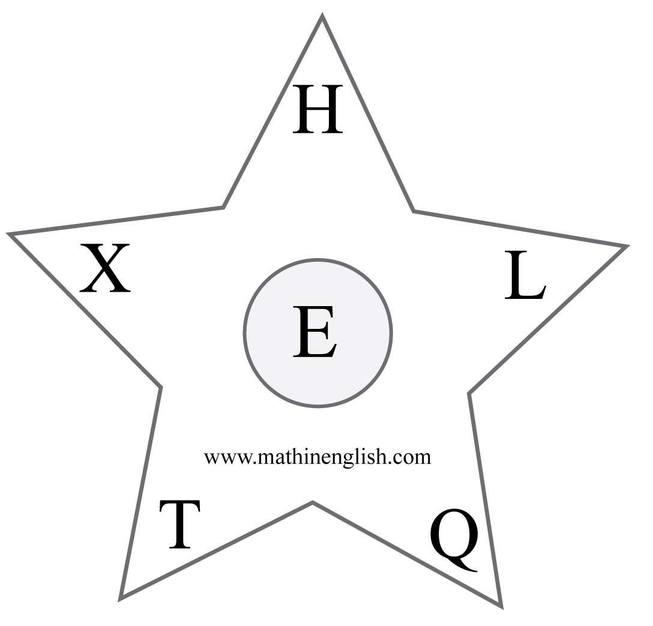
IQ Puzzle 8
Level 3B
Which letter is the odd one out?

Slide 10
IQ Puzzle 9
Level 3B
Which number is needed here?

Slide 11
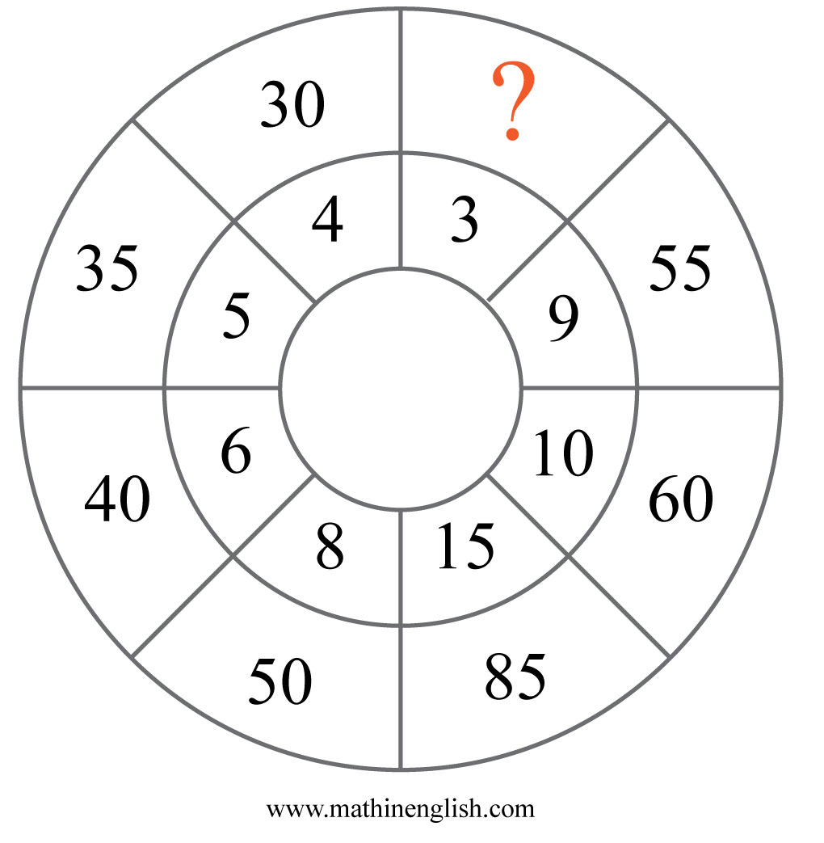
IQ Puzzle 10
Level 3B
Which number is missing?

Slide 12
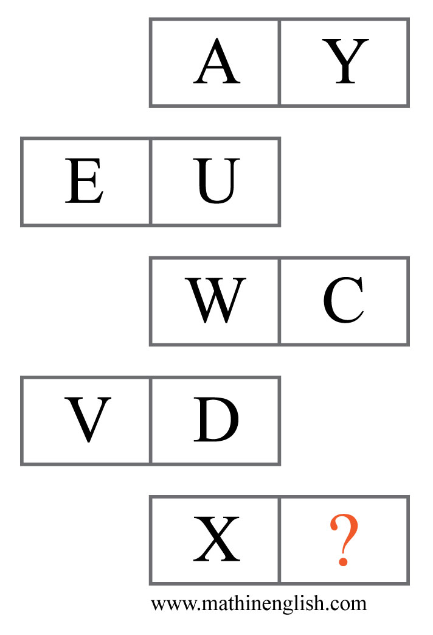
IQ Puzzle 11
Level 3B
Which letter is missing?

Slide 13
IQ Puzzle 12
Level 3B
Which letter is missing?

Slide 14
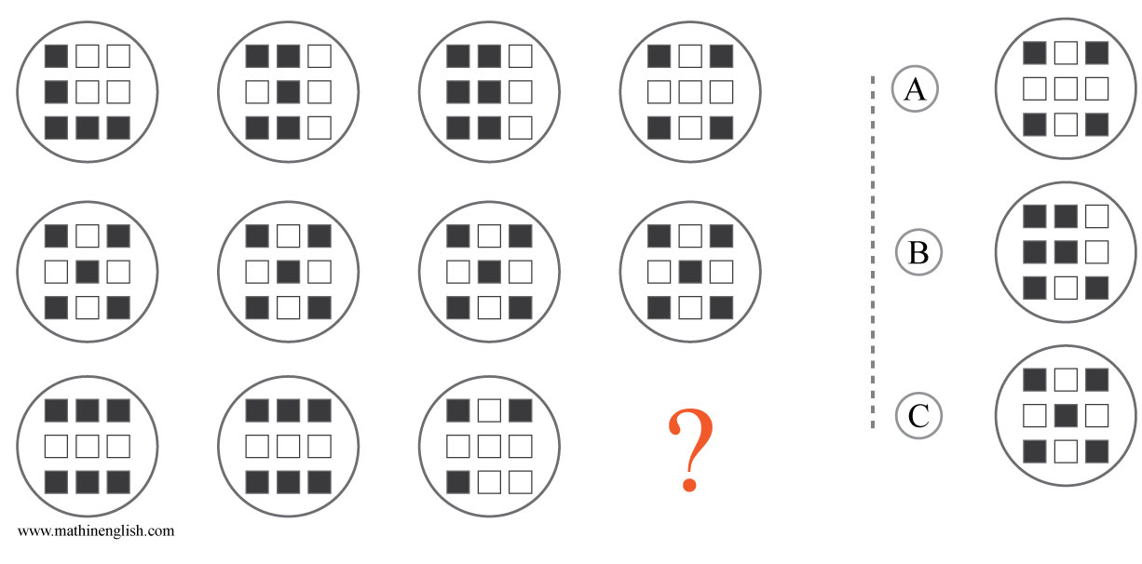
IQ Puzzle 13
Level 3B
Which option is correct?

Slide 15
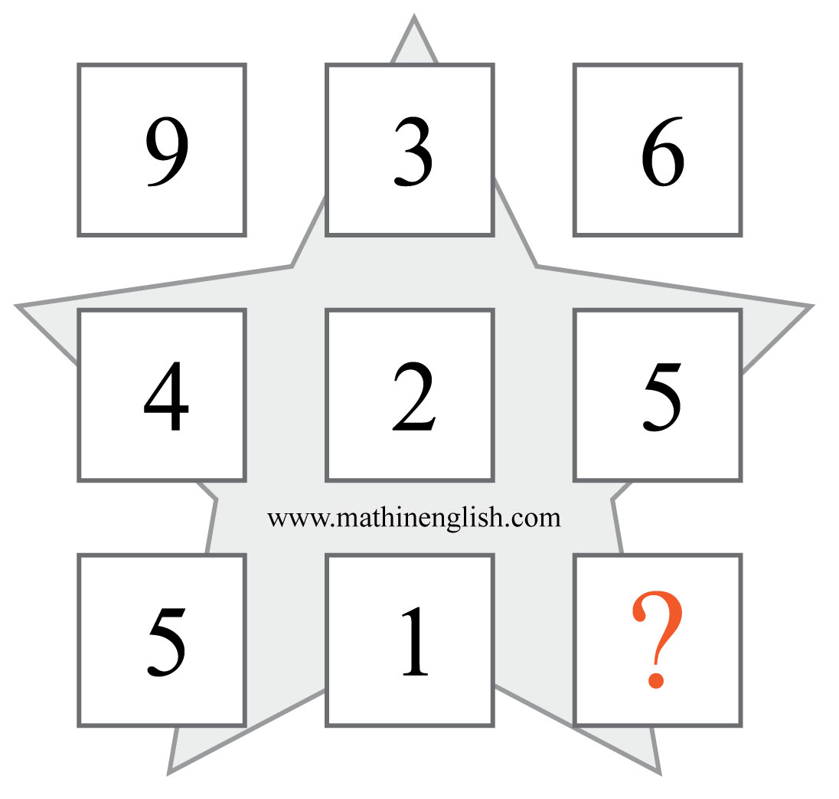
IQ Puzzle 14
Level 3B
What number is missing here?

Slide 16
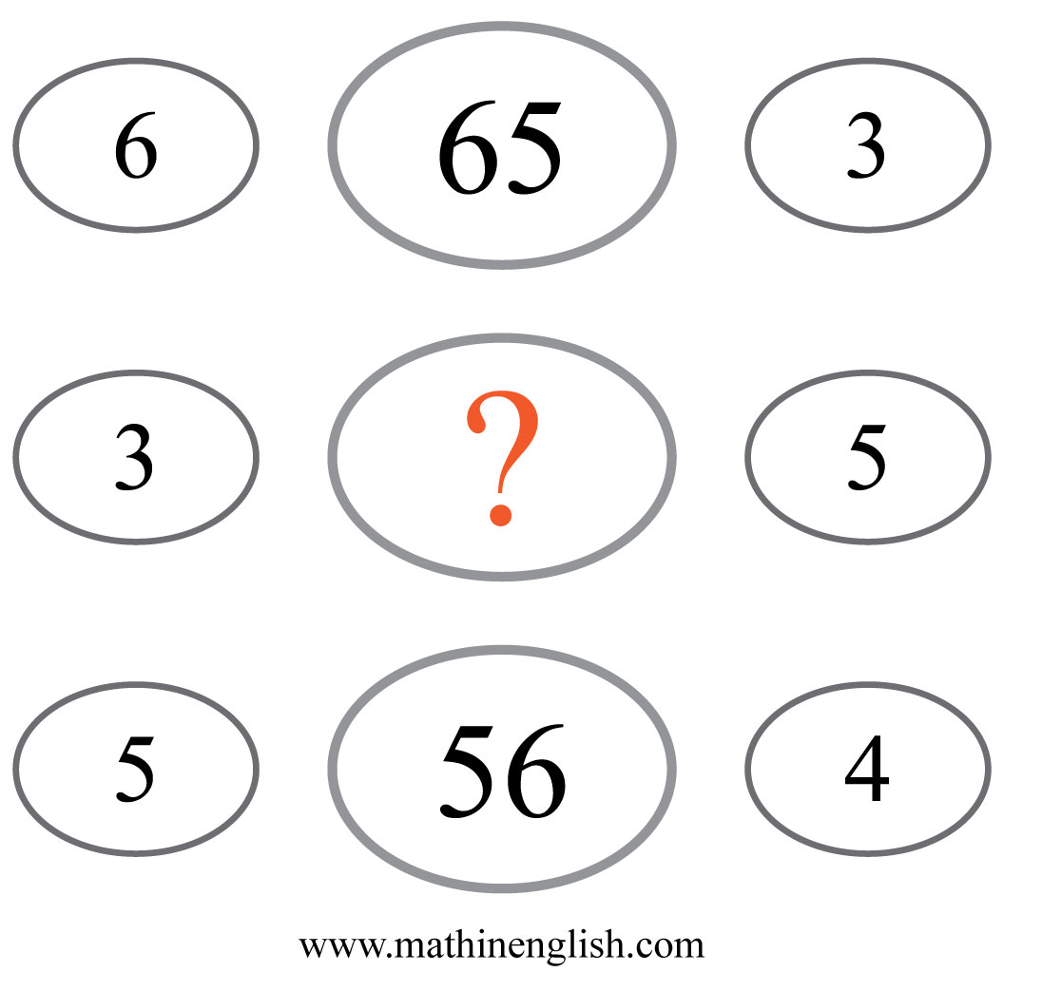
IQ Puzzle 15
Level 3B
Which number is missing?

Slide 17
IQ Puzzle 16
Level 3B
Which number is missing?

Slide 18
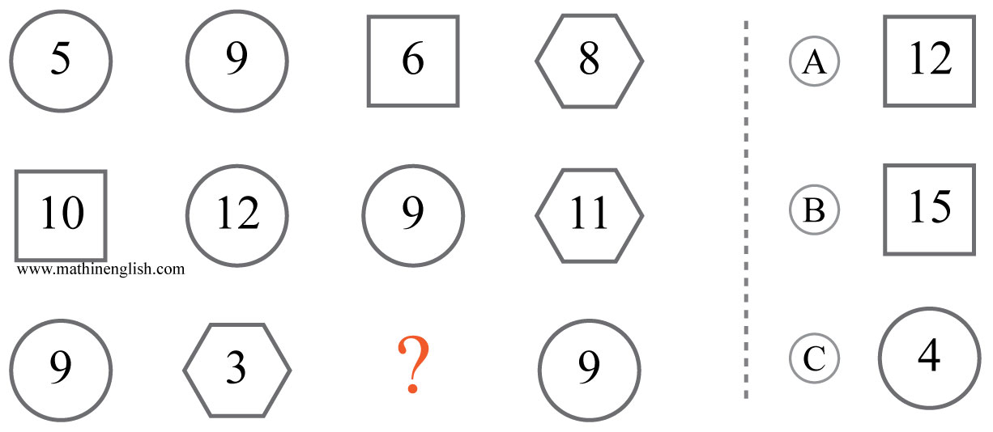
IQ Puzzle 17
Level 3B
Which option is correct?

Slide 19
IQ Puzzle 18
Level 3B
Which number is missing?

Slide 20
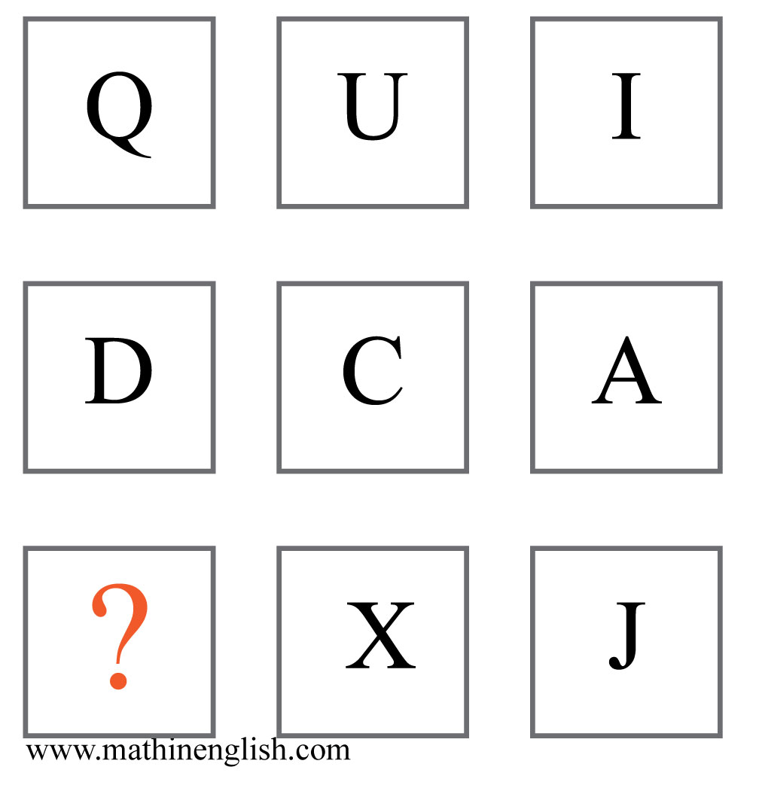
IQ Puzzle 19
Level 3B
Which letter is missing?

Slide 21
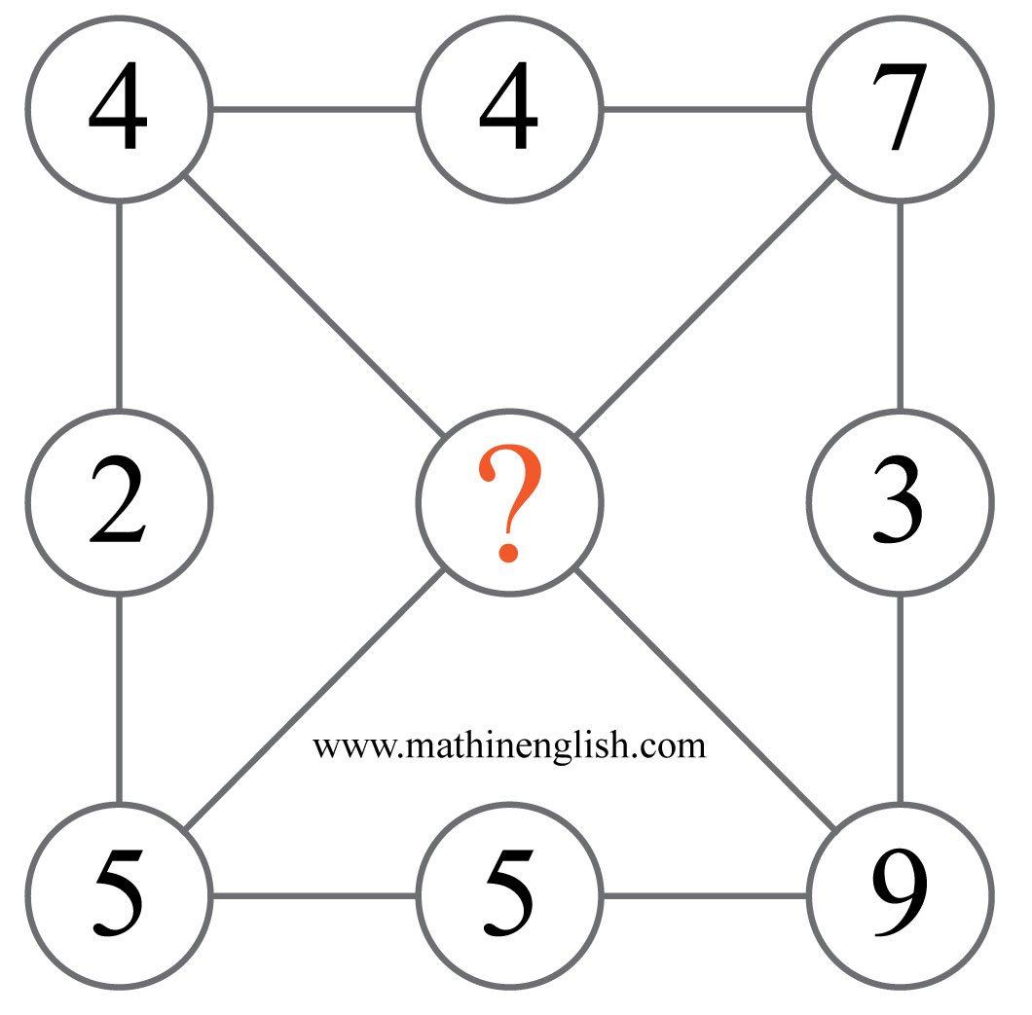
IQ Puzzle 20
Level 3B
Which number is missing?

Slide 22
Answers to puzzles 1 to 4
puzzle 1 : B
Each column of dice adds up to 10.
puzzle 2 : B
Each number is 8 more than the value of the connecting letter.
puzzle 3 : 10
The sum of 2 corner numbers divided by 3 gives the center number.
puzzle 4 : 57
The sequence follows a -3, +18 pattern.
Copyright: www.mathinenglish.com
Level 3B

Slide 23
Answers to puzzles 5 to 8
puzzle 5 : C
The value of the triangle is 4.
puzzle 6 : 6
The center number is the sum of the others in the circle + 5.
puzzle 7 : 4
Multiply the number formed by the first 2 digits in each column by 2 to
get the 3rd and 4th digit.
puzzle 8 : Q
Q is the only letter that is not entirely made up of straight lines.
Copyright: www.mathinenglish.com
Level 3B

Slide 24
Answers to puzzles 9 to 12
puzzle 9 : 30
The opposite numbers in each hexagon add up to 50.
puzzle 10 : 25
Multiply the inner numbers by 5 and add 10 to get the outer ones.
puzzle 11 : B
Each row adds up to a value of 26.
puzzle 12 : 60 and 30
The difference between the 2 cells in each row and column multiplied by 10.
Copyright: www.mathinenglish.com
Level 3B

Slide 25
Answers to puzzles 13 to 16
puzzle 13 : C
The number of shaded squares in each row adds up to 20.
puzzle 14 : 1
936 minus 425 equals 511
puzzle 15 : 37
The left and right digit plus 2 form the number in the middle.
puzzle 16 : 5
The difference between opposite numbers is 3 in each diamond.
Copyright: www.mathinenglish.com
Level 3B

Slide 26
Answers to puzzles 17 to 20
puzzle 17 : B
Each row contains 2 circles, square and hexagon. The sum of the circles is equal to that of the square and hexagon.
puzzle 18 : 10
In each row, 1 number is half of the other number in the row.
puzzle 19 : U
Add the letter values in the 1st row to those in the 2nd to get the values of the 3rd row.
puzzle 20 : 6
The difference between each opposite pair plus 1.
Copyright: www.mathinenglish.com
Level 3B

