Slide 1
IQ puzzles and brain teasers
Level 1E

Slide 2
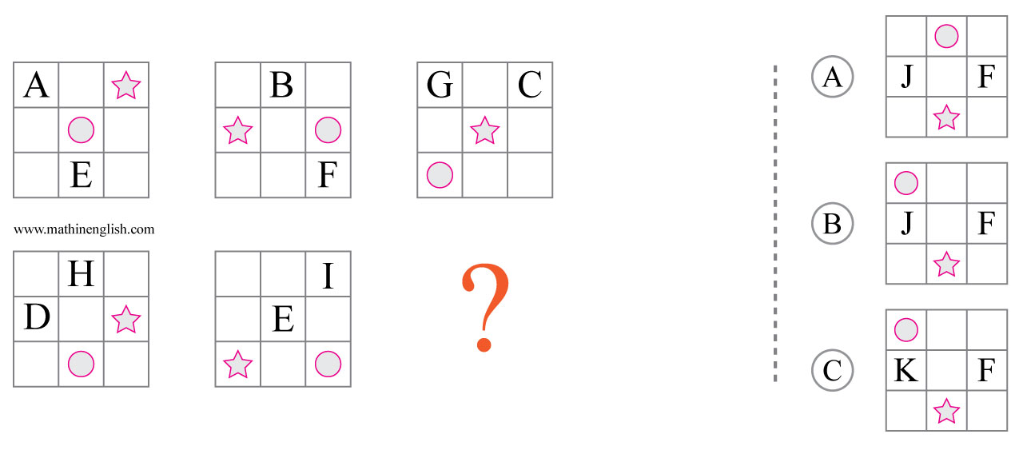
IQ Puzzle 1
Level 1E
Which option is correct?

Slide 3
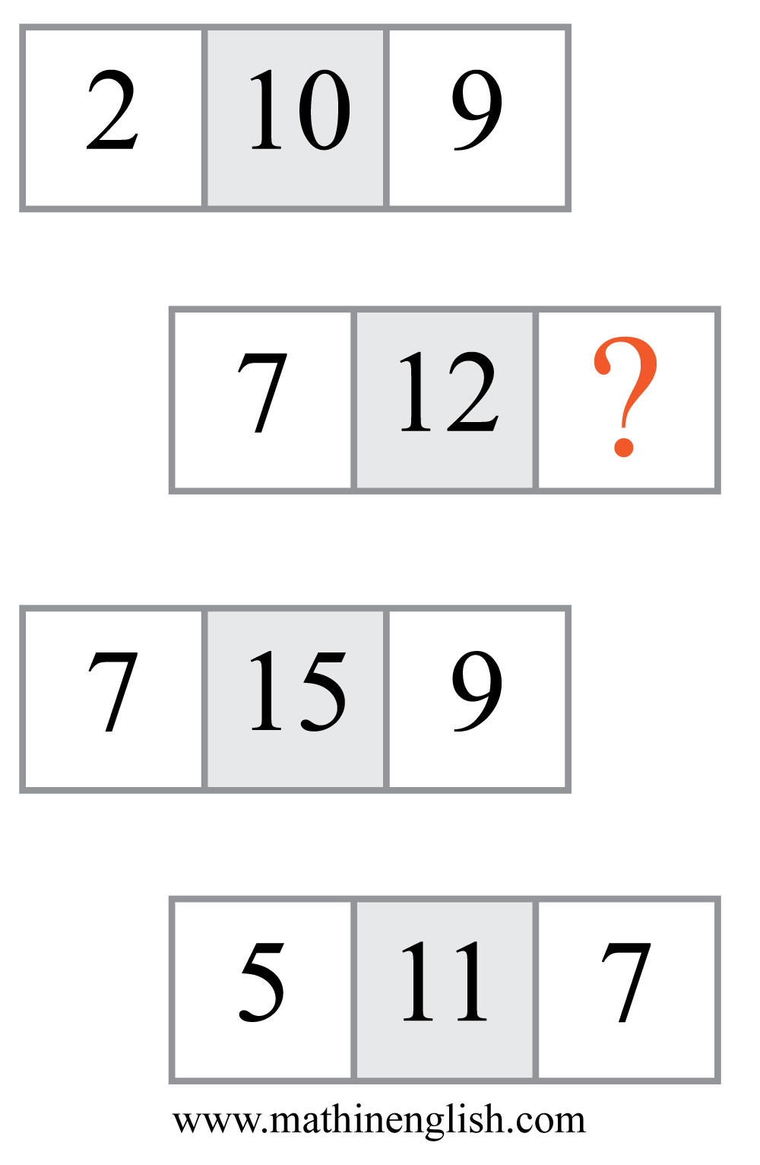
IQ Puzzle 2
Level 1E
Which number is missing?

Slide 4
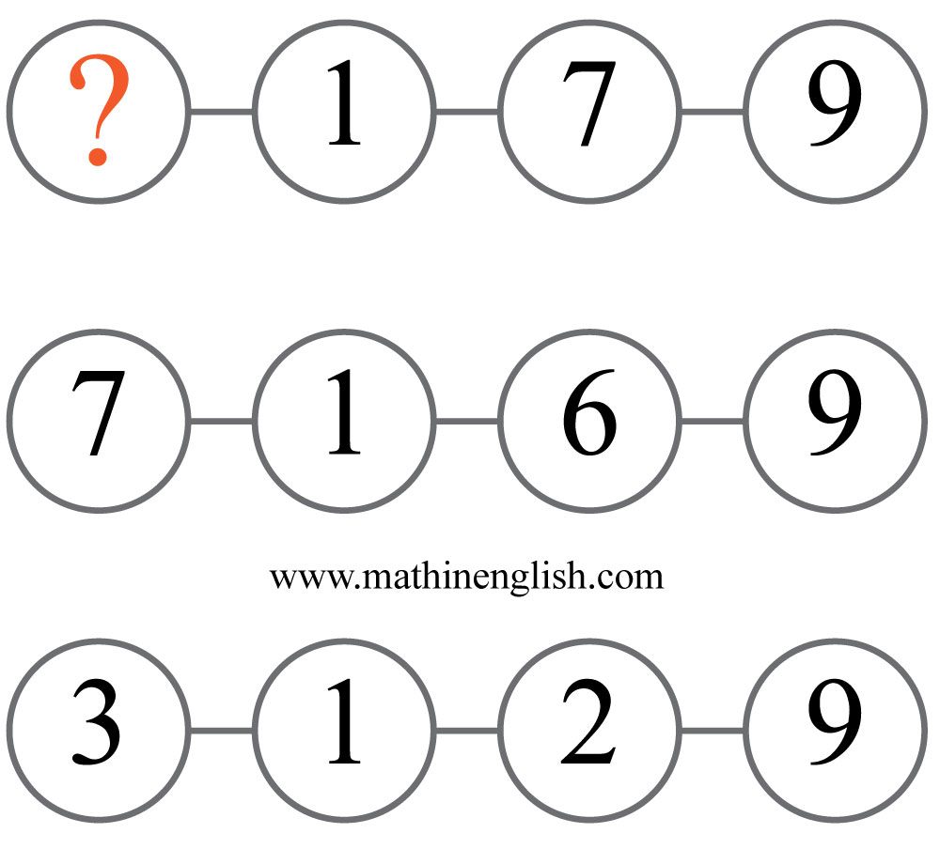
IQ Puzzle 3
Level 1E
What is the missing number?

Slide 5
IQ Puzzle 4
Level 1E
What number is needed here?

Slide 6
IQ Puzzle 5
Level 1E
What is the missing number?

Slide 7
IQ Puzzle 6
Level 1E
What is the missing time?

Slide 8
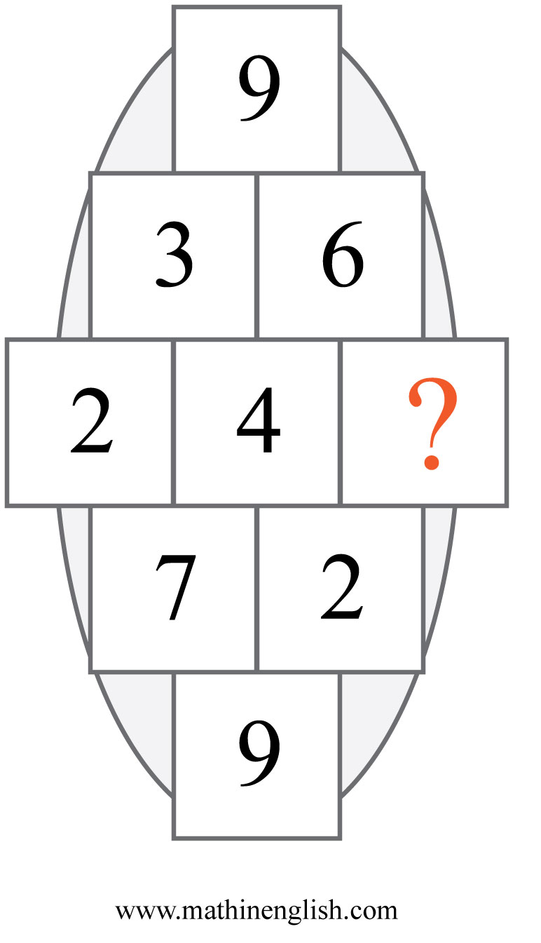
IQ Puzzle 7
Level 1E
Which number is missing?

Slide 9
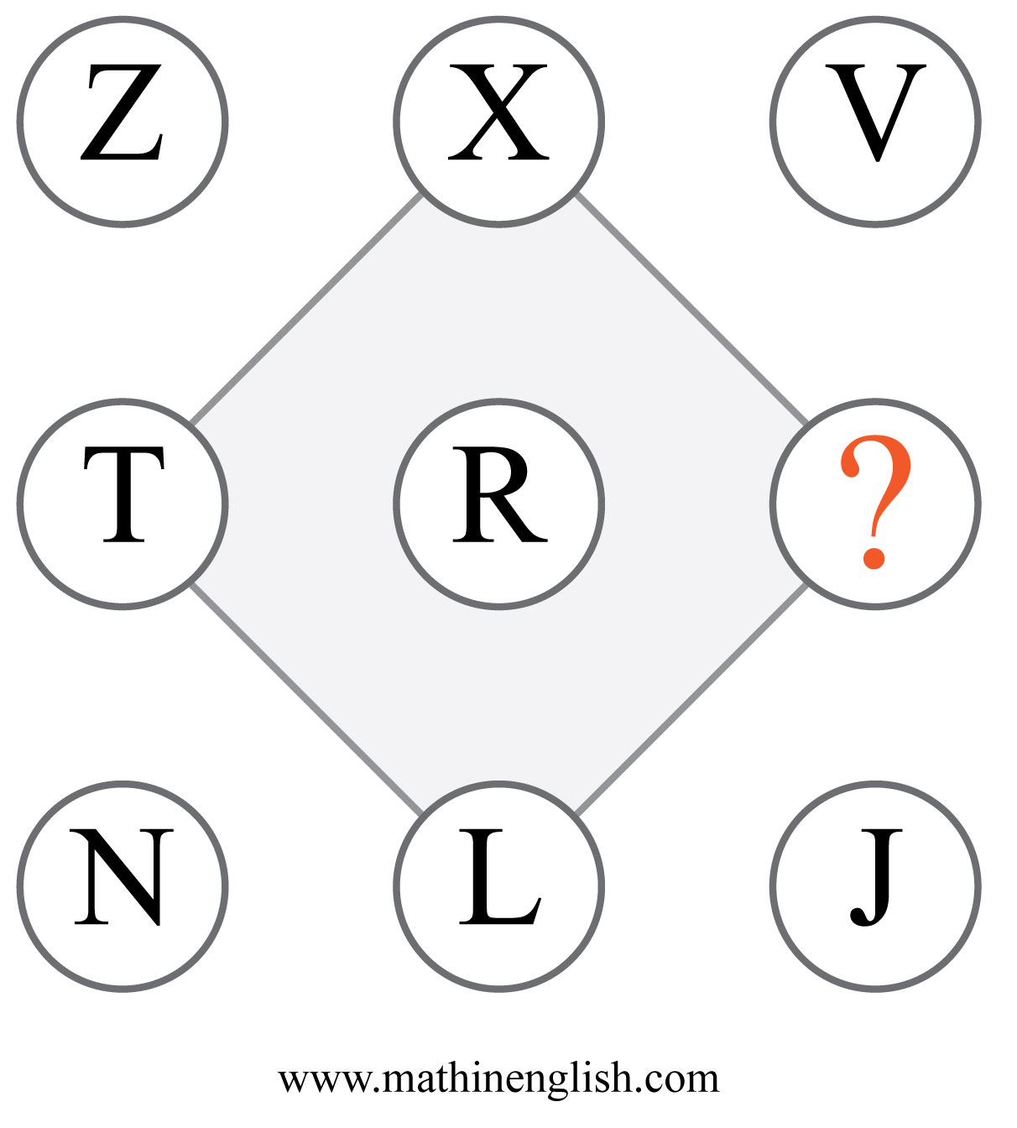
IQ Puzzle 8
Level 1E
Which letter completes the pattern?

Slide 10
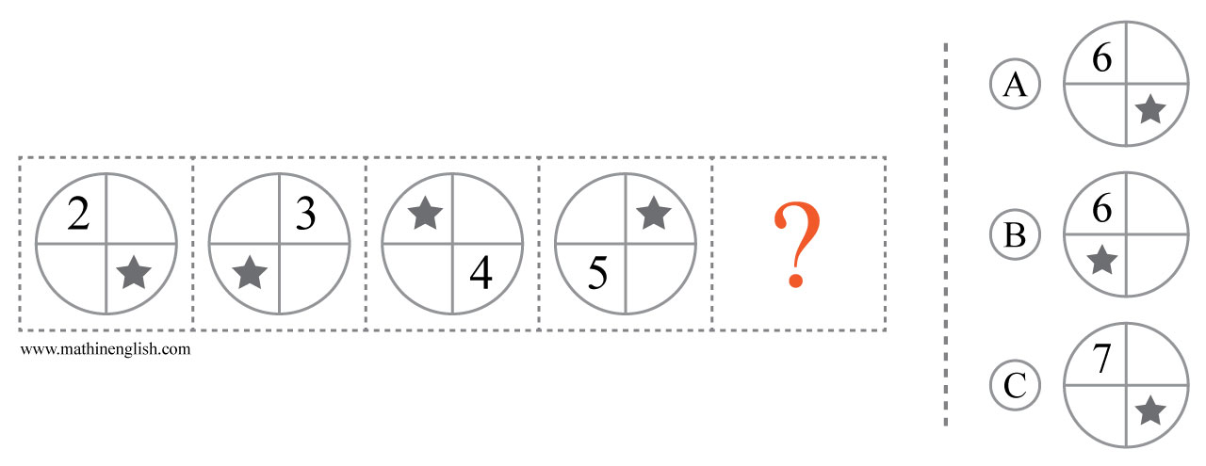
IQ Puzzle 9
Level 1E
Which option is correct?

Slide 11
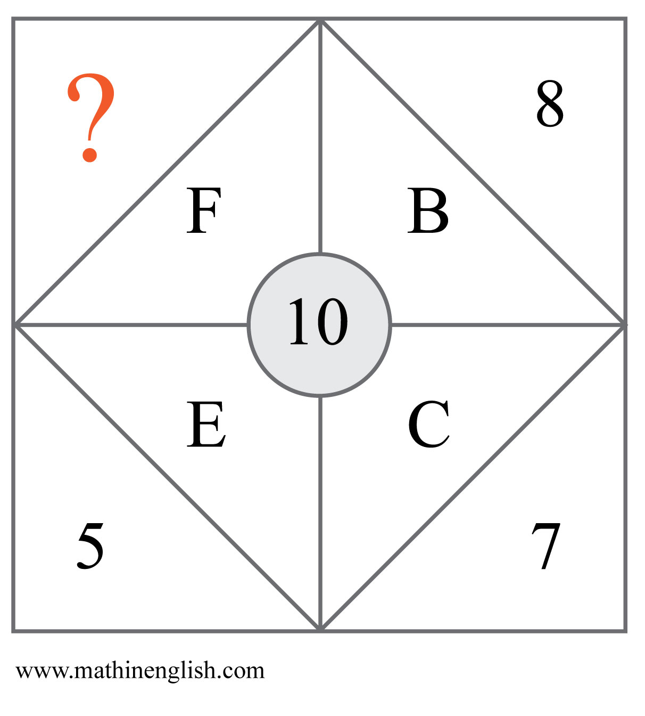
IQ Puzzle 10
Level 1E
Which number is missing?

Slide 12
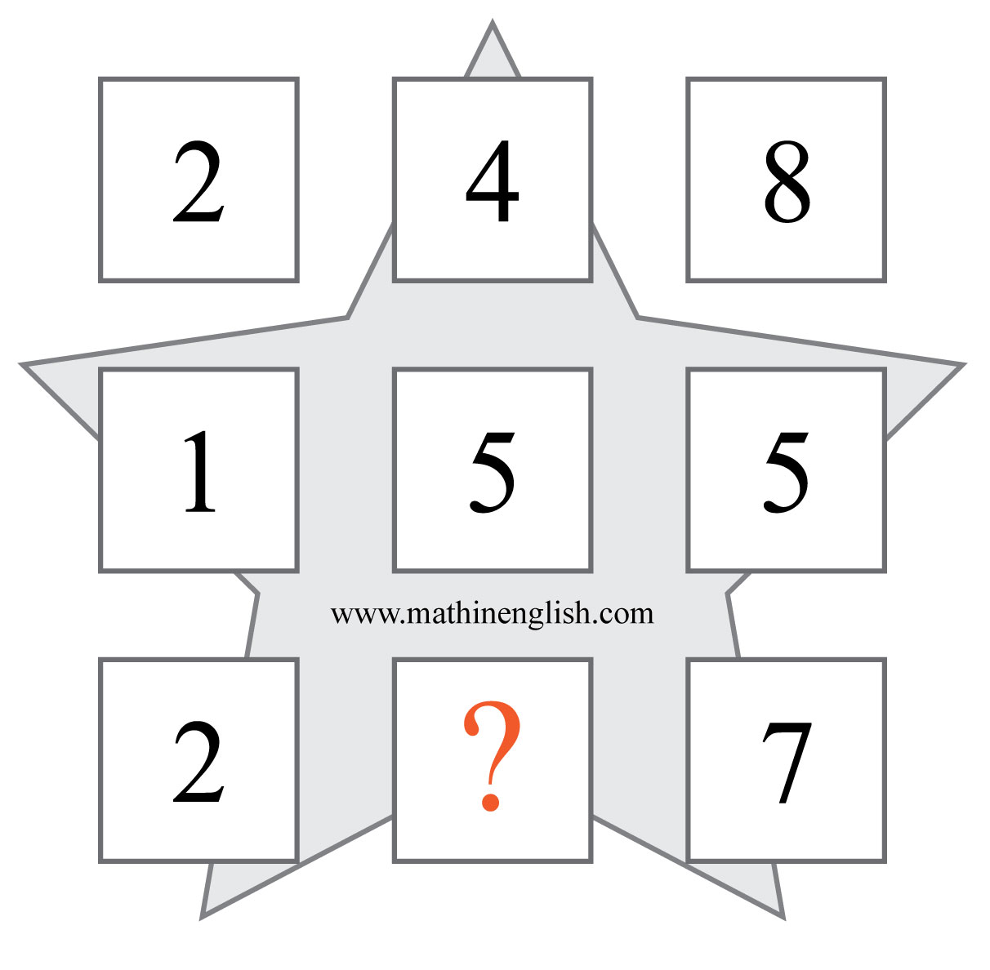
IQ Puzzle 11
Level 1E
Which number is missing?

Slide 13
IQ Puzzle 12
Level 1E
Which number completes the sequence?

Slide 14
IQ Puzzle 13
Level 1E
Which letter is missing ?

Slide 15
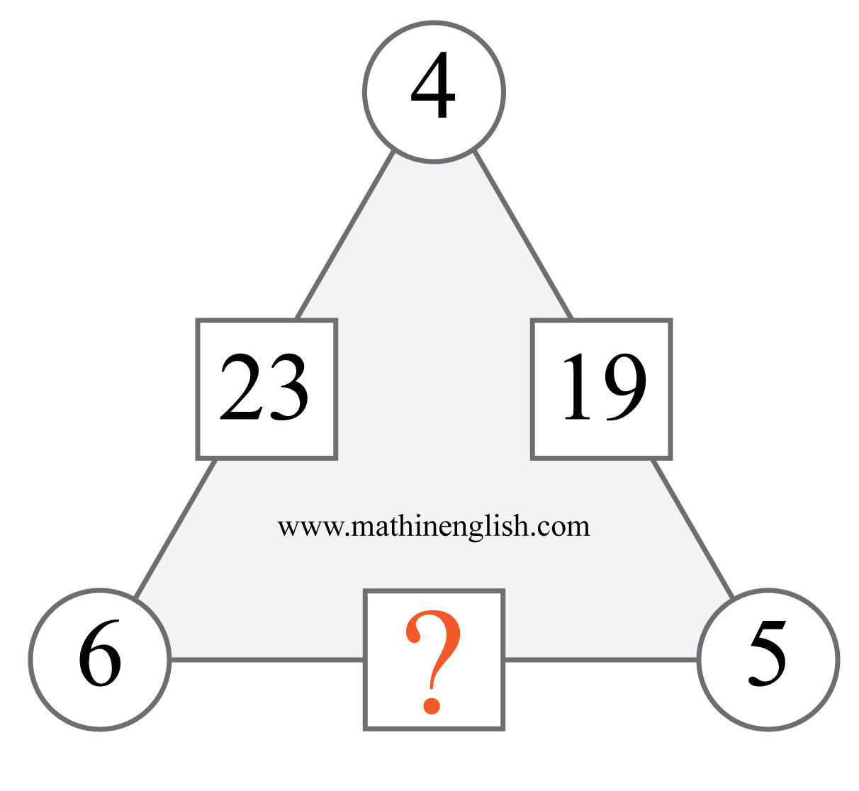
IQ Puzzle 14
Level 1E
What is the missing number?

Slide 16
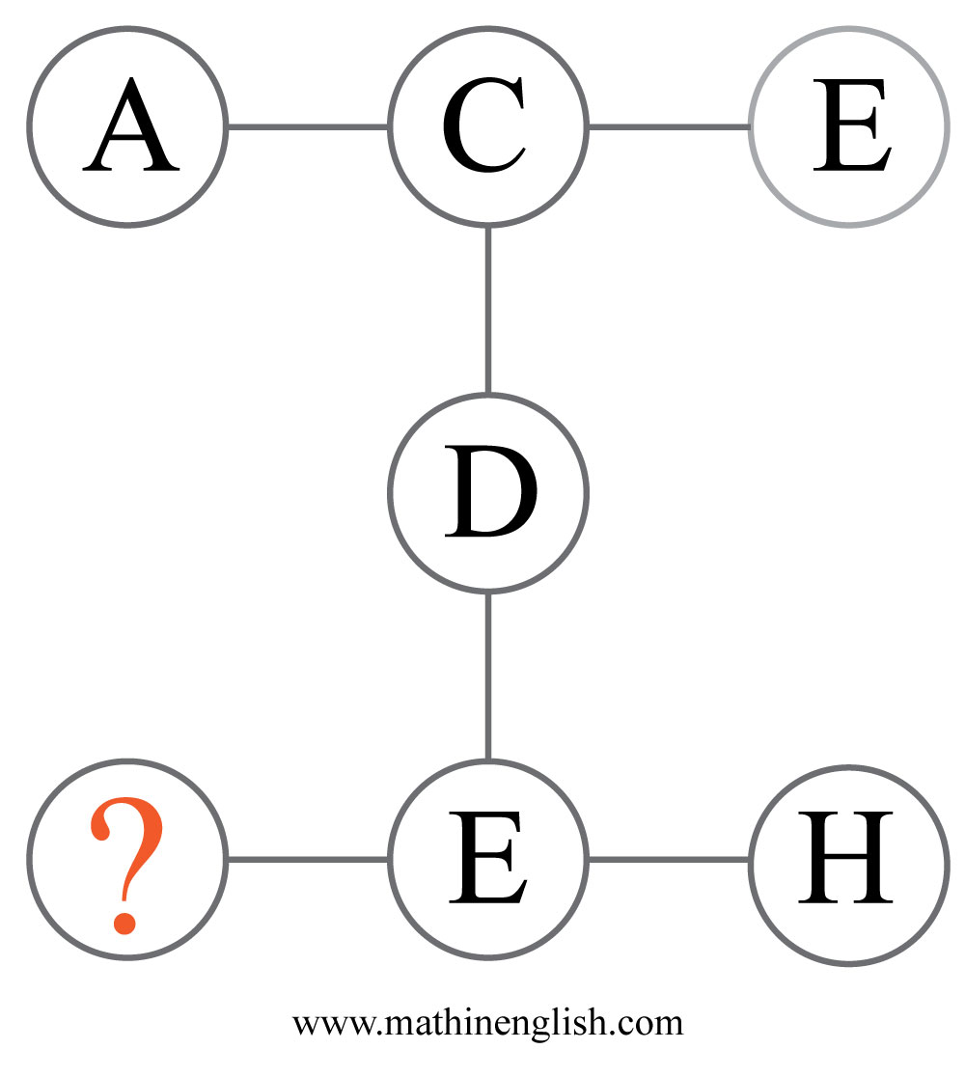
IQ Puzzle 15
Level 1E
Which letter is missing?

Slide 17
IQ Puzzle 16
Level 1E
What number is missing?

Slide 18
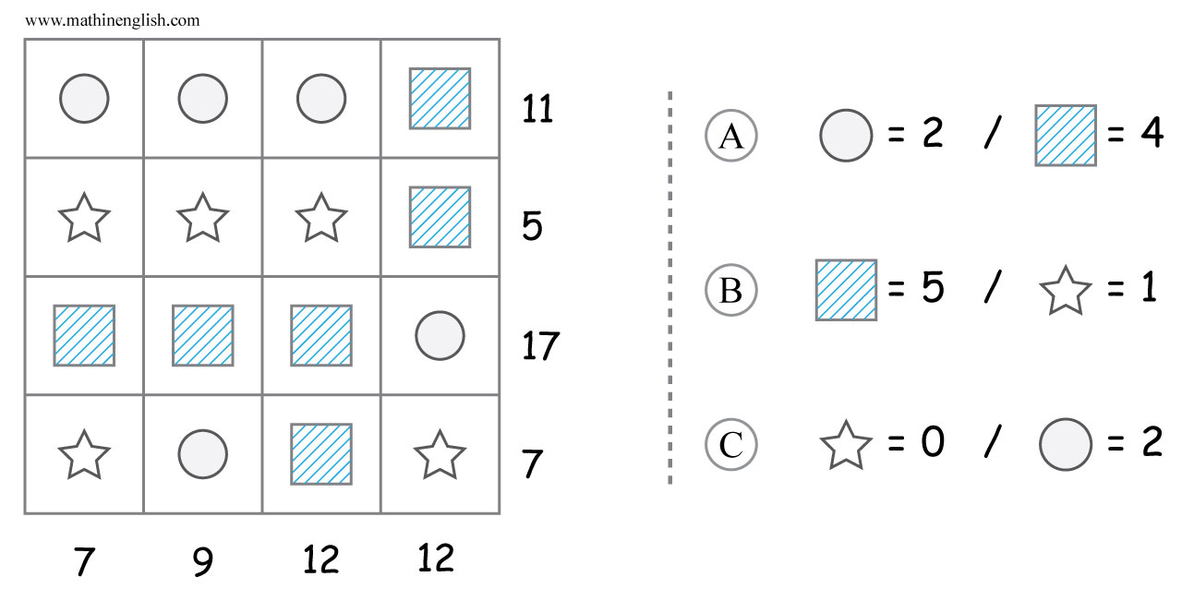
IQ Puzzle 17
Level 1E
Which option is correct?

Slide 19
IQ Puzzle 18
Level 1E
Which number is missing?

Slide 20
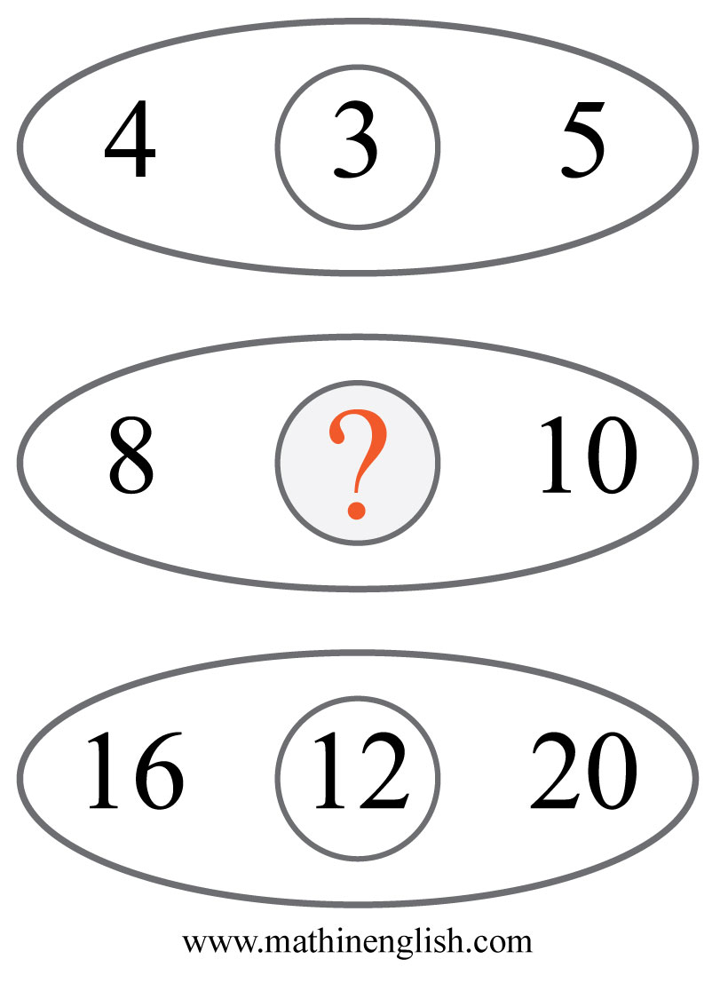
IQ Puzzle 19
Level 1E
Which numbers is missing?

Slide 21
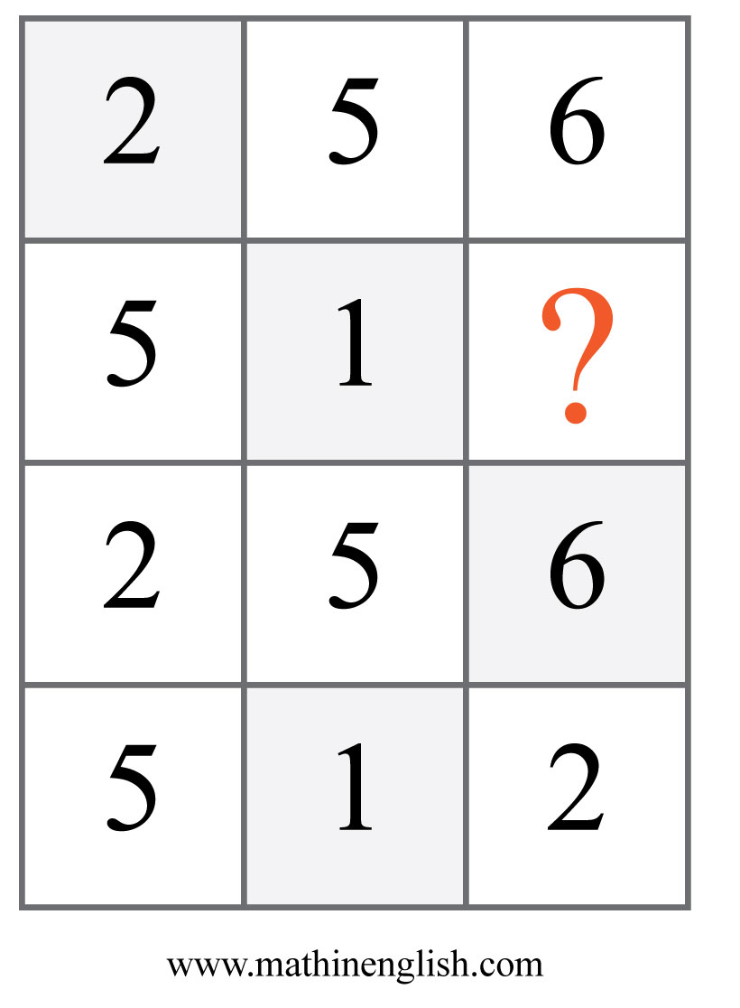
IQ Puzzle 20
Level 1E
Which number is missing here?

Slide 22
Answers to puzzles 1 to 4
puzzle 1 : B
Each symbol moves 1 position in the next square.
puzzle 2 : 6
7 and 6 make 13, and minus 1 gives the middle number 12.
puzzle 3 : 8
The sum of the numbers on the left and right are the same as the
2 digits in the middle.
puzzle 4 : 4
In the top rows the first 2 numbers multiplied give the 3rd number.
In the lower row, you must divide.
Copyright: www.mathinenglish.com
Level 1E

Slide 23
Answers to puzzles 5 to 8
puzzle 5 : 4
Add the lower 3 numbers in each diamond and add 1 to the sum to
get the top number.
puzzle 6 : 7:25
Each watch shows a time 40 minutes earlier than the preceeding one.
puzzle 7 : 3
Each row adds up to 9.
puzzle 8 : P
Each row follows a decreasing pattern of minus 2 letters.
Copyright: www.mathinenglish.com
Level 1E

Slide 24
Answers to puzzles 9 to 12
puzzle 9 : A
Each step, the circles and symbols are rotating one step clockwise
(90 degrees).
puzzle 10 : 4
4 and the letter value of F equal the center number 10.
puzzle 11 : 1
Divide the left 2 cells in each row by 3 to get the 3rd cell.
puzzle 12 : 16
The pattern is plus 1, minus 3.
Copyright: www.mathinenglish.com
Level 1E

Slide 25
Answers to puzzles 13 to 16
puzzle 13 : Y
E times E, 5 times 5, equals 25 or Y.
puzzle 14 : 29
6 times 5 minus 1.
puzzle 15 : B
B = 2, H = 8, with an average of 5, or E.
puzzle 16 : 20
20 minus 15 plus 20 equals 25.
Copyright: www.mathinenglish.com
Level 1E

Slide 26
Answers to puzzles 17 to 20
puzzle 17 : C
Fill in to check.
puzzle 18 : 33
The pattern is plus 3, plus 6.
puzzle 19 : 6
Add the left and right numbers and divide by 3.
puzzle 20 : 2
The 2nd row is 2 times the 1st row. The 4th row is 2 times the 3rd row.
Copyright: www.mathinenglish.com
Level 1E

